Slide 1
DESIGN MATTERS
Designing a learning environment for creative thinkers, innovators, and problem solvers

Slide 3
Conceptual Age
Innovative Thinking
Information Age
Knowledge
Industrial Age
Factory work
Agricultural Age
Farm work

Slide 4
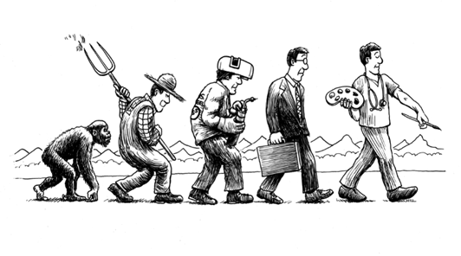

Slide 5
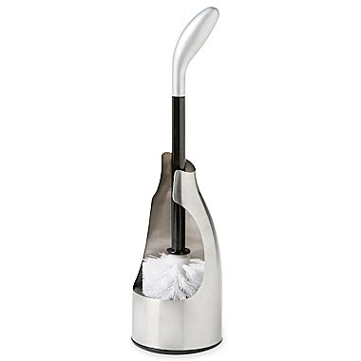
Michael Graves Toilet Brush for Target

Slide 6
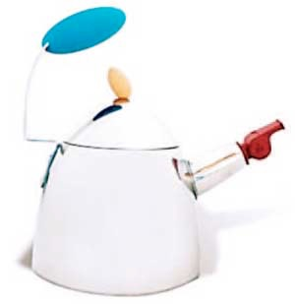
Michael Graves Teapot for Target

Slide 7
John Maeda, President of RISD
Graduate of MIT - Computer Science
Technology & Design = Simplicity

Slide 8
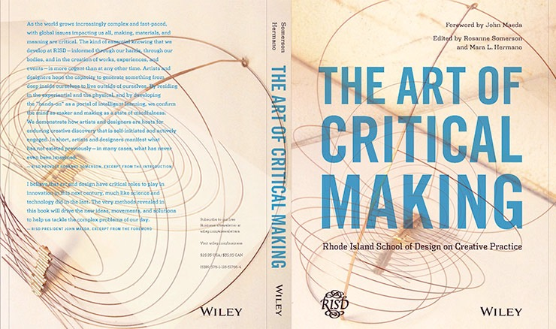
Rhode Island School of Art & Design

Slide 9
PHYSICAL SPACE
SEATING
TEMPERATURE
LIGHTING
NOISE

Slide 10
PHYSICAL SPACE
DESIGN
CREATING A NEUTRAL PALETTE
INTEREST CREATED BY HIGH CONTRAST

Slide 11
2013 HGTV URBAN OASIS DREAM HOME

Slide 12
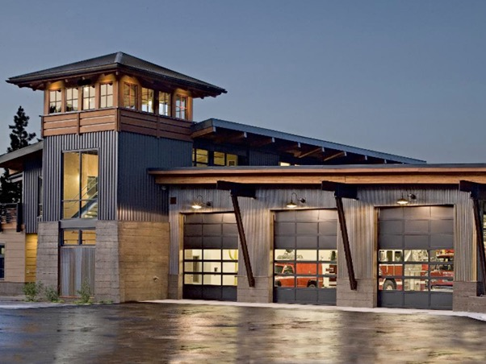

Slide 13
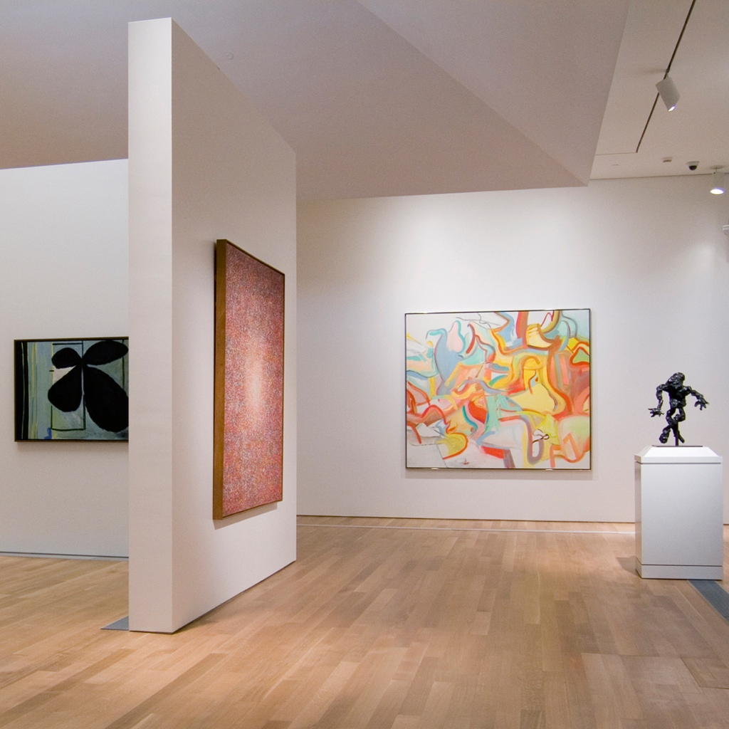

Slide 14
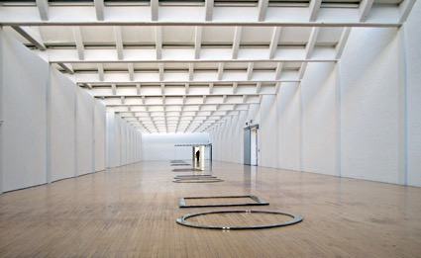
DIA: BEACON

Slide 15
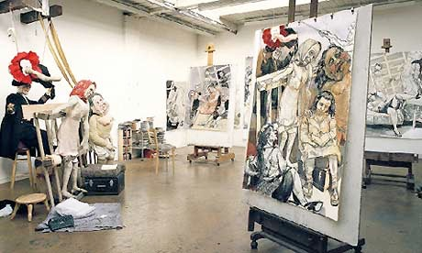

Slide 16
ATMOSPHERE
MEANING
COLLABORATION
COMMUNITY
SAFE/SECURE ENVIRONMENT
EXPERIMENT
EXPLORE

Slide 17
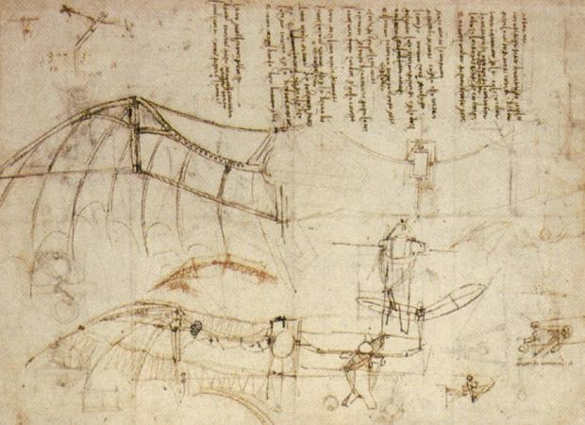
THINK LIKE
DA VINCHI

Slide 18
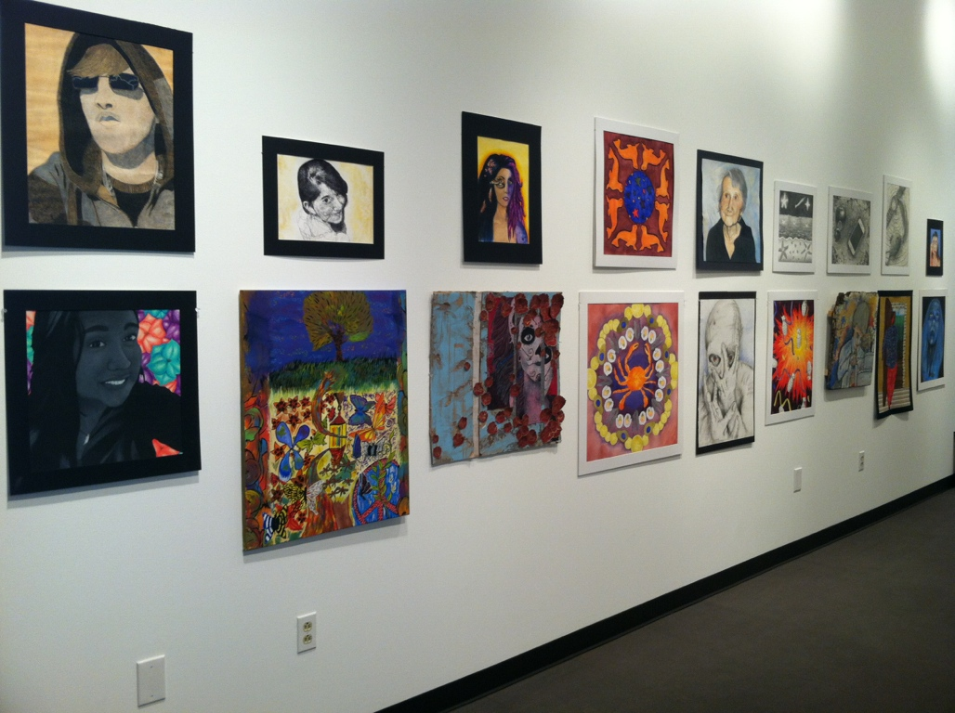
THE ART ROOM IS
NOT
A WORK OF ART

Slide 19
DESIGN MATTERS
Design influences our brain activity and our responses.
Design an environment that promotes creativity!

Slide 20
Jennifer Swenson
jenswenson.com/educator
jswenson@lincolnlutheran.org

